Slide 1
The Download: Community Tech Talks Episode 16
August 2, 2018

Slide 2

Welcome!
Please share: Let others know you are here with #HPCCTechTalks
Ask questions! We will answer as many questions as we can following each speaker.
Look for polls at the bottom of your screen. Exit full-screen mode or refresh your screen if you don’t see them.
We welcome your feedback - please rate us before you leave today and visit our blog for information after the event.
Want to be one of our featured speakers? Let us know! techtalks@hpccsystems.com

Slide 3


Reminder: 2018 HPCC Systems Community Day, Atlanta
Poster abstracts due September 7
Sponsor packages still available
Workshop & Poster Competition on October 8
Main event on October 9
Registration opens early August!
Visit hpccsystems.com/hpccsummit2018
Call for Presentations No Open

Slide 4

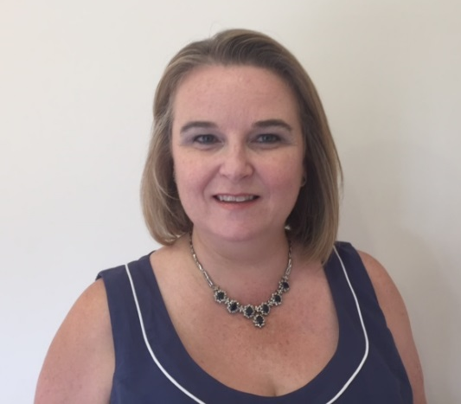
Today’s Guest Moderator
Lorraine Chapman
Consulting Business Analyst & Internship Program Manager
LexisNexis® Risk Solutions
Lorraine.chapman@lexisnexisrisk.com
Lorraine has worked alongside software developers for over 20 years in a supportive role which has ranged from producing documentation including developing on-line help systems to software testing and release management. Lorraine also administers the HPCC Systems Intern Program and manages our application to be an accepted organization for Google Summer of Code. Lorraine is an active blogger on our website covering a wide range of subjects from new release information, features and improvements and the work students have completed during their internships.

Slide 5
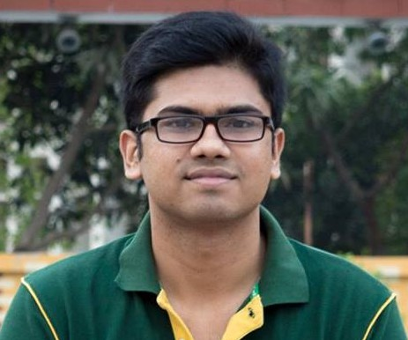
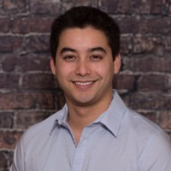


Today’s speakers
Shah Muhammad Hamdi HPCC Systems Summer Intern PhD Student Georgia State University shamdi1@student.gsu.edu
Shah Muhammad Hamdi is a Ph.D. student (3rd year) in the Department of Computer Science of Georgia State University. He works in Data Mining Lab (DMLab) under the supervision of Dr. Rafal Angryk. His research interests are machine learning, data mining and deep learning, more specifically, finding interesting patterns from real-life graphs and time series data. His research finds applications in the fields of solar weather analysis and neurological disease prediction. Before joining the DMLab for the Ph.D., he worked one year as a Lecturer in Computer Science in Northern University Bangladesh, Dhaka, Bangladesh. He received his Bachelor degree in Computer Science in 2014 from Rajshahi University of Engineering and Technology (RUET), Rajshahi, Bangladesh.
Robert Kennedy
HPCC Systems Summer Intern PhD Student Florida Atlantic University
rkennedy@fau.edu
Robert Kennedy is a first year Ph.D. student in CS at Florida Atlantic University with research interest is in Deep Learning and parallel and distributed computing. His current research is in improving distributed deep learning by implementing and optimizing distributed algorithms.

Slide 6
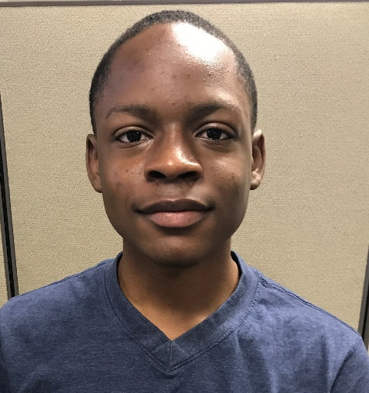
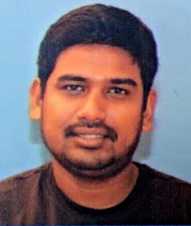


Today’s speakers
Aramis Tanelus HPCC Systems Summer Intern Advanced Robotics Team American Heritage High School aramis.tanelus@lexisnexisrisk.com
Aramis Tanelus is a programmer and senior at American Heritage High Schools where he is the lead programmer for the Advanced Robotics Team. He works with the ROS operating system collecting data from robots developed by the team and turns it into actionable output to help with robotic tasks. He current is an intern in Boca Raton working on a project to develop software interfaces between robotic sensors and the HPCC Systems platform.
Saminda Wijeratne
HPCC Systems Summer Intern Masters Student Georgia Institute of Technology
samindaw@gatech.edu Saminda Wijeratne is a Masters student in the Department of Computational Science and Engineering of Georgia Institute of Technology. His area of research is High Performance Computing in Distributed clusters and AI areas such as ML and Neural networks. His adviser is Dr. Srinivas Aluru professor and co-Executive Director in Georgia Tech IRI in Data Engineering and Science. Saminda was a senior software engineer for 3 years in the industry at WSO2, an open source technology provider which offers an enterprise platform. He obtained his Bachelor of Computer Science from University of Moratuwa, Sri Lanka.

Slide 7
Parallel Distributed Deep Learning on HPCC Systems
Robert Kennedy
HPCC Systems Summer Intern PhD Student Florida Atlantic University
rkennedy@fau.edu

Slide 8
Quick poll: Do you currently use machine learning in your current work and are you using HPCC Systems or other platforms for building the models? See poll on bottom of presentation screen

Slide 9
Background
Expand HPCC Systems complex machine learning capabilities
Current HPCC Systems ML libraries have common ML algorithms
Lacks more advanced ML algorithms, such as Deep Learning
Expand HPCC Systems libraries to include Deep Learning

Slide 10
Presentation Outline
Project Goals
Problem Statement
Brief Neural Network Background
Introduction to Parallel Deep Learning Methods and Techniques
Overview of the Technologies Used in this Implementation
Details of the Implementation
Implementation Validation and Statistical Analysis
Future Work

Slide 11
Project Goals
Extend HPCC Systems Libraries to include Deep Learning
Specifically Distributed Deep Learning
Combine HPCC and TensorFlow
Widely used open source DL library
HPCC Provides:
Cluster environment
Distribution of data and code
Communication between nodes
TensorFlow Provides:
Deep Learning training algorithms for localized execution

Slide 12
Problem Statement
Deep Learning models are large and Complex
DL needs large amounts of training data
Training Process
Time requirements increase with data size and model complexity
Computation requirements increase as well
Large multi node computers are needed to effectively train large, cutting edge Deep Learning models

Slide 13
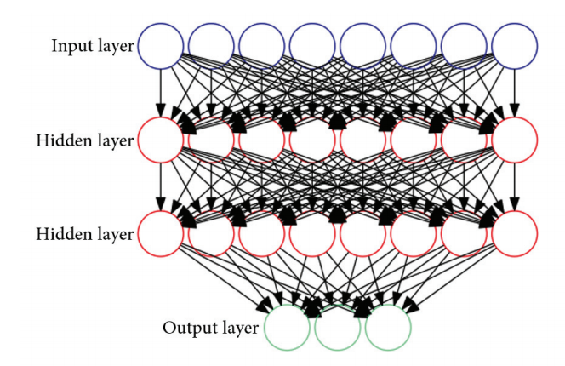
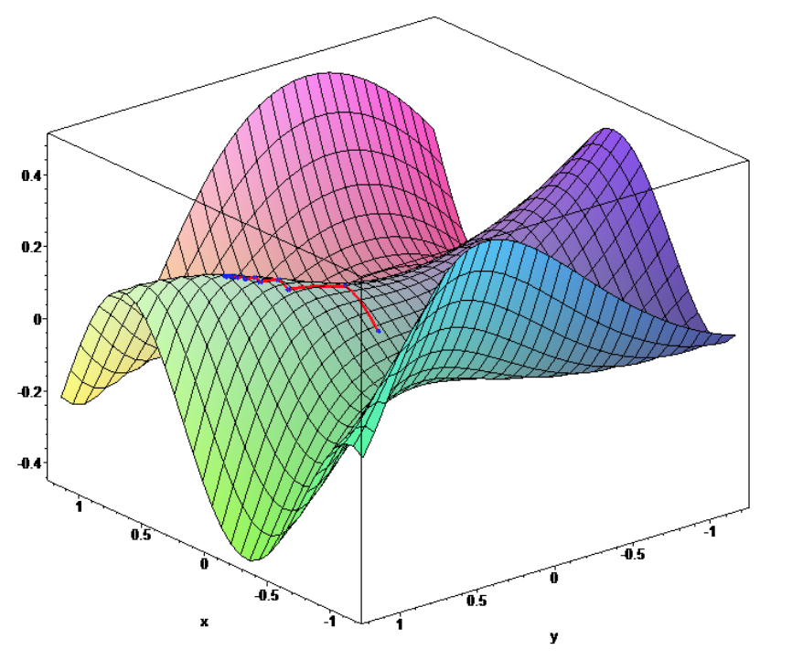
Neural Network Background
Neural Network Visualization
2 hidden layers, fully connected, 3 class classification output
Forwardpropagation and Backpropagation
Optimize Model with respect to Loss Function
Gradient Descent, SGD, Batch SGD, Mini-batch SGD

Slide 14
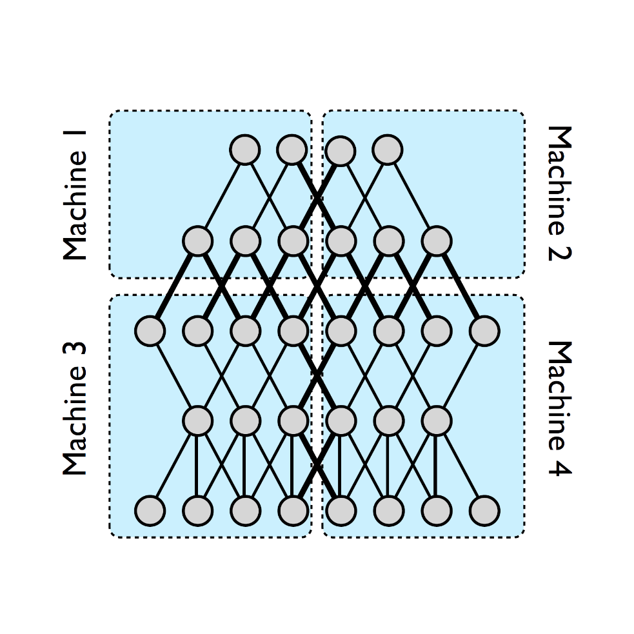
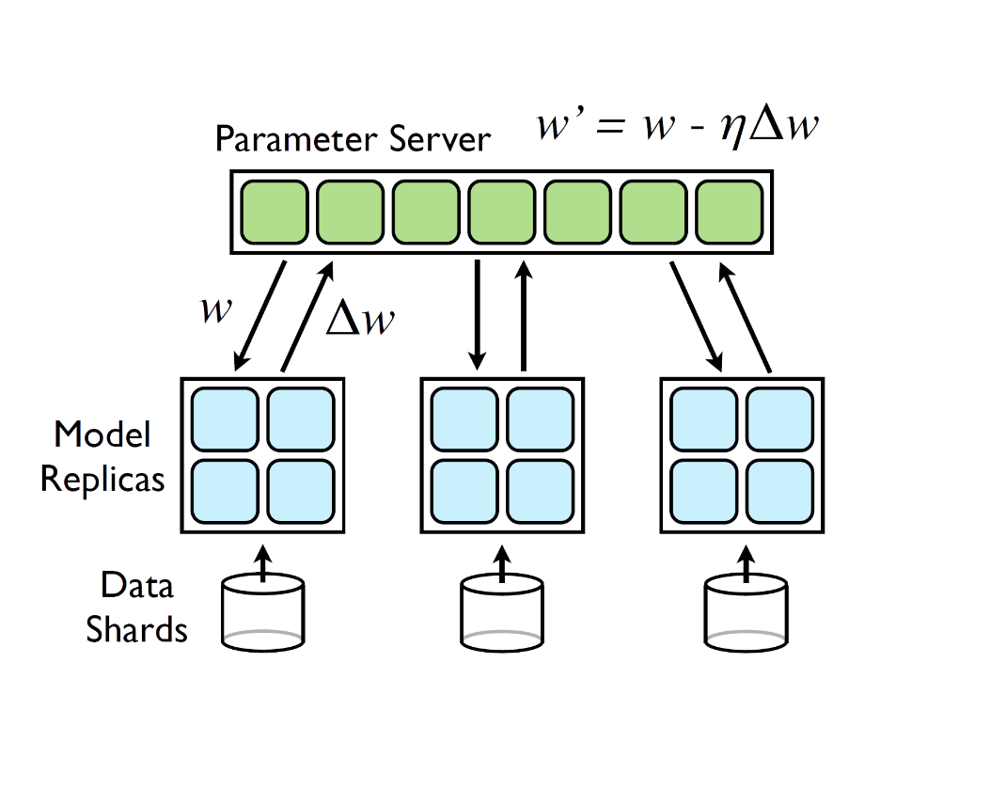
Parallel Deep Learning
Data Parallelism
Model Parallelism
Synchronous and Asynchronous
Parallel SGD
Data Parallelism Model Parallelism

Slide 15
Implementation – Overview
ECL/HPCC Handles the ‘Data Parallelism’ part of the parallelization
Pyembed handles the localized neural network training
Using Python, TensorFlow, Keras, and other libraries
The implementation is a synchronous data parallel stochastic gradient descent
However, it is not limited to using SGD at a localized level
The implementation is not limited to TensorFlow
Using Keras, other Deep Learning ‘backends’ can be used with no change in code

Slide 16
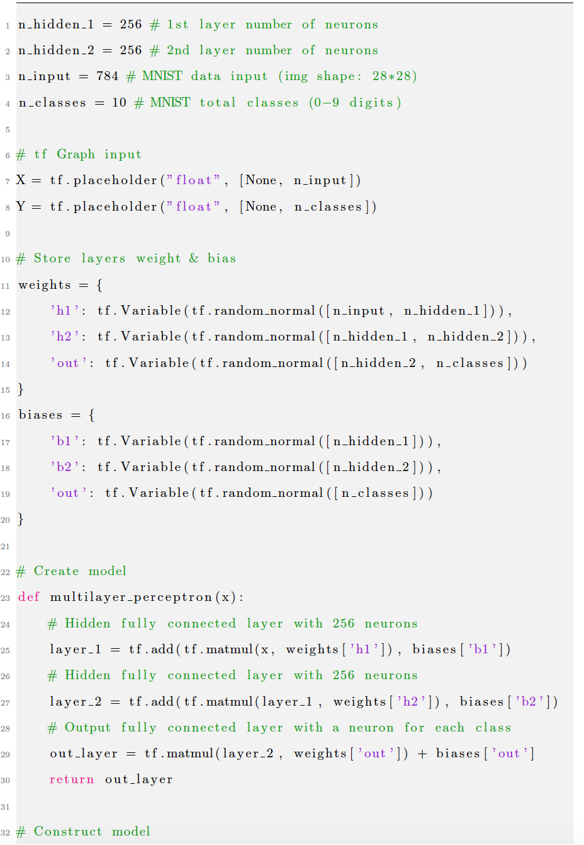
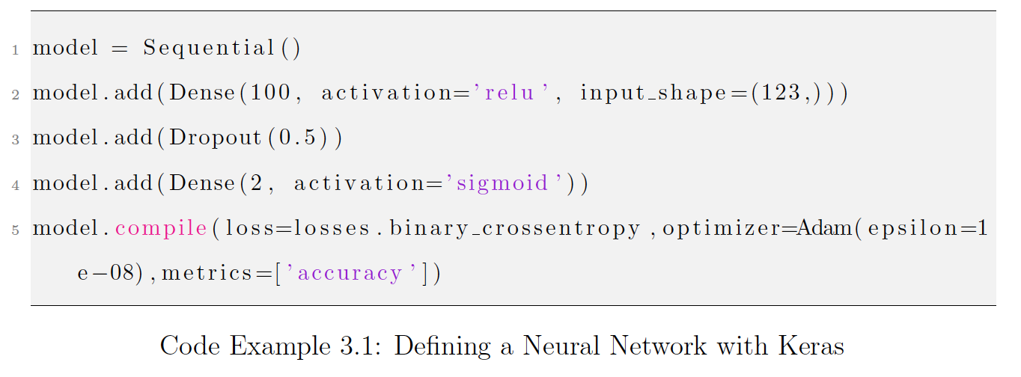
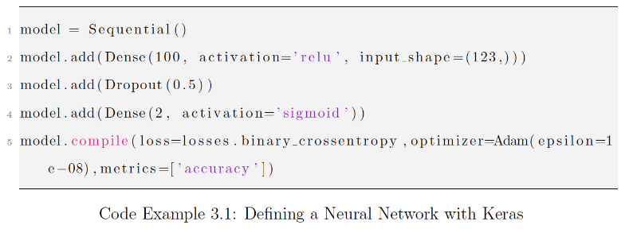
TensorFlow | Keras
TensorFlow
Google’s Popular Deep Learning Library
Keras
Deep Learning Library API – uses TensorFlow or other ‘backend’
Much less code to produce same model

Slide 17
Implementation - HPCC and ECL
ECL Partitions Training Data into N partitions
Where N is the number of slave nodes
Pyembed – plugin that allows ECL to execute python code
ECL Distributes the Pyembed code along with data to each node
Passes into Pyembed the data, NN model, and meta-data as parameters

Slide 18
Implementation – Pyembed
Receives parameters at time of execution, passed in from ECL
Then converts to types usable by the python libraries
Builds localized NN model from the inputs
Recall this is iterative so the input model changes on each Epoch
Trains the inputted model on its partition of data
Returns the updated model weights once completed
Does not return any training data

Slide 19
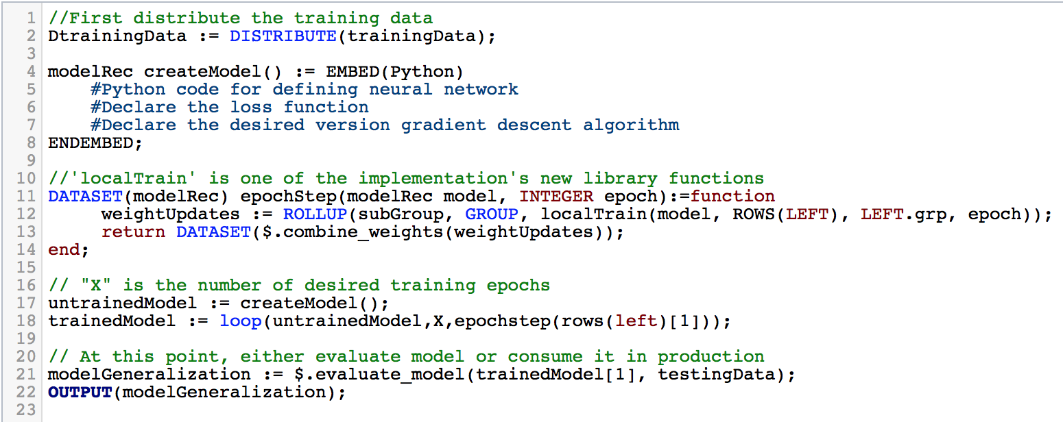
Code Example – Parallel SGD

Slide 20
Case Study – Training Time – Design
Using a ‘big-data’ dataset, 3,692,556 records long
Each record is 850 bytes long
80/20 Split for Training and Testing Datasets
We use 10 (from the 80 split) data set sizes, each with different class imbalance ratios
1:1, 1:5, 1:10, 1:25, 1:50, 1:100, 1:500, 1:1000, 1:1500, 1:2000
Ranging from 2,240 records to 2,241,120 records
1.9 MB to 1.9 GB in size
Each dataset is run on 5 different cluster sizes
1 node, 2 nodes, 4 nodes, 8 nodes, and 16 nodes
Cluster is cloud based and each node has 1 CPU and 3.5 gigs of memory

Slide 21
Case Study – Training Time – Results
Note the Y scale of the Left graph is logarithmic

Slide 22
Case Study – Model Performance
Uses same experimental design as previous case study
Model performance is slightly improved by number of nodes
See: slope of the red line
Other dataset sizes’ model performance effects out of scope
Due to the severe class imbalance

Slide 23
Future Work
Improved Data Parallelism
For HPCC systems with multiple slave Thor nodes on a single logical computer
Model Parallelism Implementation
Hybrid Approach – Model and Data parallelism
Asynchronous Parallelism
This paradigm has additional challenges on a cluster system

Slide 24
Conclusion
Successful Implementation of a synchronous data parallel deep learning algorithm
Case Studies show the runtime is valid across a wide spectrum of clusters sizes and dataset sizes
Leveraged HPCC Systems and TensorFlow to bring Deep Learning to HPCC
Started new open source HPCC Library for distributed DL
Accompanying Documentation, Test cases, and Performance tests
Provided possible research avenues for future work

Slide 25
Quick poll: What role do you see HPCC Systems filling in the domain of Deep Learning? See poll on bottom of presentation screen

Slide 26
Questions?
Robert Kennedy
HPCC Systems Summer Intern PhD Student Florida Atlantic University
rkennedy@fau.edu

Slide 27
Submit a talk for an upcoming episode!
Have a new success story to share?
Want to pitch a new use case?
Have a new HPCC Systems application you want to demo?
Want to share some helpful ECL tips and sample code?
Have a new suggestion for the roadmap?
Be a featured speaker for an upcoming episode! Email your idea to Techtalks@hpccsystems.com
Visit The Download Tech Talks wiki for more information: https://wiki.hpccsystems.com/display/hpcc/HPCC+Systems+Tech+Talks
Stay tuned for our next Tech Talk! Watch our Events page for details.

Slide 28
Thank You!
A copy of this presentation will be made available soon on our blog: hpccsystems.com/blog

